Slide 1

CEMA Health System
Internship Task | Centre for Epidemiological Modelling and Analysis (CEMA)

Slide 2
Project Overview
🧬 Health Programs
👤 Client Registration
🔄 Enrollment
Manage structured health initiatives and services efficiently.
Secure onboarding and management of client data.
Track client enrollments and program participation.
👓 Profile View
🌐 API Access
Access detailed client profiles with essential information.
Enable seamless integration via RESTful API services.

Slide 3
Technologies Used
Backend
Database
Frontend
API Format
Node.js + Express for scalable server-side logic
SQLite for lightweight and efficient data storage
HTML, CSS, JavaScript for responsive user interfaces
RESTful JSON endpoints for interoperability

Slide 4

API Endpoints
Method
Endpoint
Purpose
POST
S
Create a new health program
/api/programs
POST
/api/clients
Register a new client
GET
/api/clients/:id
View client profile data
POST
/api/enrollments
Enroll client into a program

Slide 5
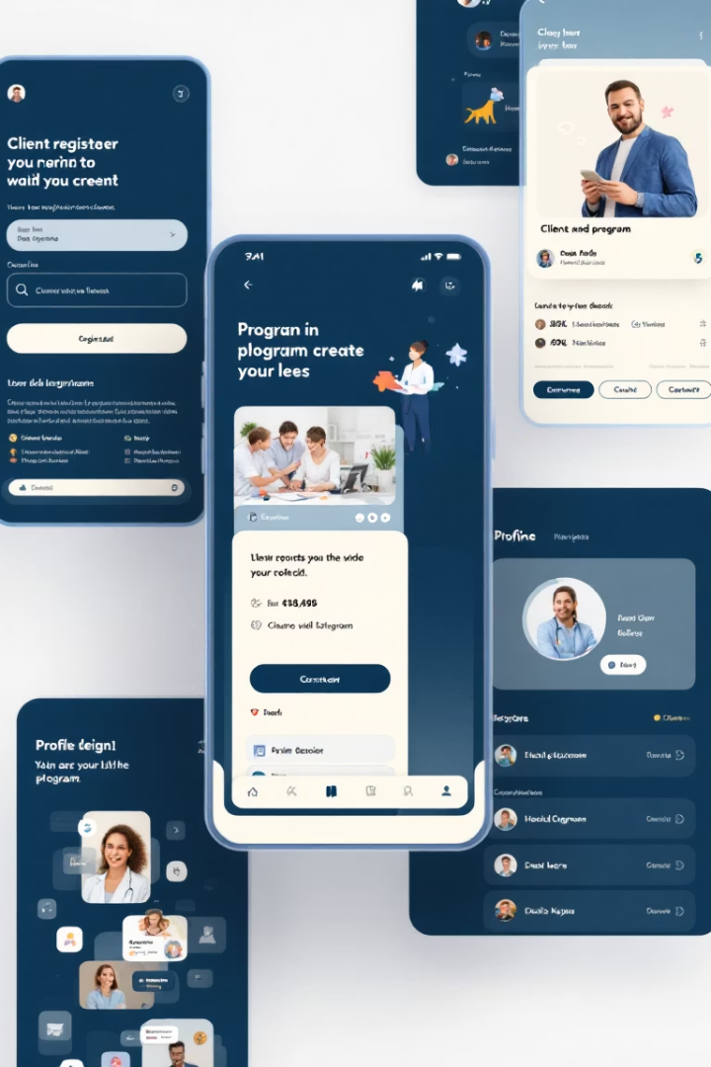



Interactive Frontend
Step 1
Create health programs easily
Step 2
Register clients securely
Step 3
View and manage client profiles

Slide 6





Highlights & What Went Well
Clean Design
Intuitive and user-friendly interface
Easy Structure
Well-organized backend and frontend integration
API-Ready
Supports external integration seamlessly
Demo Simplicity
Clear for demonstration and stakeholder review

Slide 7

Final Ambient Touches
Consistent Color Palette
Blue, green, white, and grey shades unify the design
Rounded Shapes & Soft Shadows
Creates a modern and approachable look
Progress Indicator
Footer progress bar keeps audience oriented
Smooth Transitions
Fade and zoom effects enhance presentation flow

Slide 8

Thank You / Questions?
Name: Christopher Nathan Akwabi
Role: Software Engineer Intern Applicant

